Slide 1
Introduction to Arrays
ELEC1006: ENGINEERING COMPUTING

Slide 2

Array
Array: variable that can store multiple values of the same type.
Values are stored in adjacent memory locations.
Declared using [] operator:
int tests[5];
In the definition int tests[5];
int is the data type of the array elements.
tests is the name of the array.
5, in [5], is the size declarator. It shows the number of elements in the array.
PAGE 2

Slide 3
Array Memory Layout
The definition:
int tests[5];
allocates the following memory:
first element | second element | third element | fourth element | fifth element
PAGE 3

Slide 4
Size of an Array
The size of an array is:
the total number of bytes allocated for it.
(number of elements) * (number of bytes for each element).
Examples:
int tests[5] is an array of 20 bytes, assuming 4 bytes for an int.
long double measures[10]is an array of 80 bytes, assuming 8 bytes for a long double.
PAGE 4

Slide 5
Size Declarators
Named constants are commonly used as size declarators. const int SIZE = 5; int tests[SIZE];
This eases program maintenance when the size of the array needs to be changed.
PAGE 5

Slide 6
Array Subscript
Each element in an array is assigned a unique subscript.
Subscripts start at 0.
The last element’s subscript is n-1 where n is the number of elements in the array.
subscripts:
0 | 1 | 2 | 3 | 4
PAGE 6

Slide 7
Accessing Array Elements
Array elements can be used as regular variables:
tests[0] = 79;
cout << tests[0];
cin >> tests[1];
tests[4] = tests[0] + tests[1];
Arrays must be accessed via individual elements:
cout << tests; // illegal
PAGE 7

Slide 8
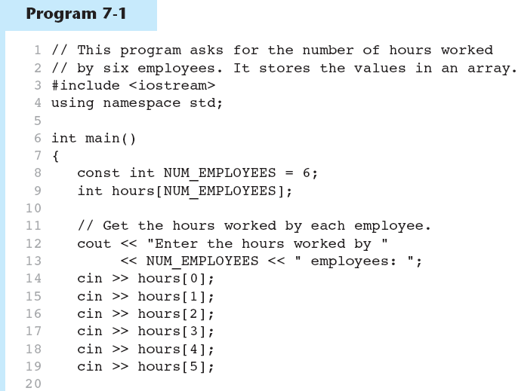
Example 1
PAGE 8

Slide 9
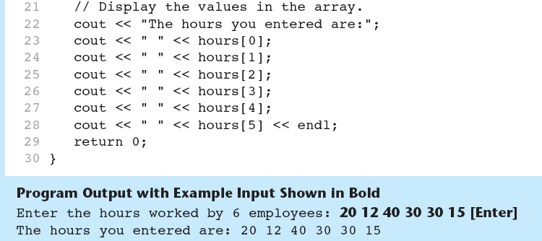
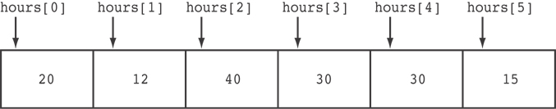
Example 1 (continued)
Here are the contents of the hours array, with the values entered by the user in the example output:
PAGE 9

Slide 10
More info
[1] cplusplus.com: Arrays
https://www.cplusplus.com/doc/tutorial/arrays/
[2] learncpp.com: 6.1 – Arrays (Part I)
https://www.learncpp.com/cpp-tutorial/61-arrays-part-i/
PAGE 10

